Slide 1

E-Placement Portal
Gandharvi Walavekar (20104045)
Vaishnavi Shinde (20104002)
Kanan Sananse(20104125)
Shruti Pinjarkar(20104016)
Project Guide
Prof. Nahid Shaikh

Slide 2
Contents
Introduction
Objectives
Scope
Features / Functionality
Project Outcomes
Technology Stack
Block Diagram if applicable

Slide 3
1. Introduction
Training and management of placement is a crucial part of an educational institution in which most of the work is done manually.
The project is aimed at developing an application for the placement department of the college.
The major problem is searching and updating of the student data. It is difficult for Placement Officers to collect, manage, and update student data as the number of students keeps on increasing.
Our job portal helps both the job seekers and recruiters finding the right organization for the employees and It is a platform where students can view and assess their opportunities

Slide 4
2. Objectives
To develop a system to enable interaction between employers and applicants.
To manage the details of student records and placements.
To filter the list of eligible students easily.
To reduce manual work to manage the details of student records.

Slide 5
3. Scope
Admin can store detailed information of the candidates and can short list according to the requirement criteria.
Various companies can also access and search desired candidate on Online E-placement portal.
E-placement portal can be accessed through HR and job seekers with login information.
Candidates can register and upload their CV on E-placement portal online over internet.
Its a web based project so candidates can access it over internet saves their time and money to travel.

Slide 6
4. Features
The Features of our project are as follows :
Using this system, the administrators can maintain the academic information of each student such as semester results, resume and all the information.
CV can be easily stored in database and can be accessed by admin.
User can check their job application status via status page provided on the dashboard.

Slide 7
5. Outcome of Project
The outcome of the project is as follows:
1.User can access the job portal with proper login credentials.
2.User can apply for jobs available in their respective branches by providing the following inputs:
a. Personal details including name, email id,cgpa, etc
b. A copy of their resume .
3.Admin can approve and reject a candidate
4. Admin can edit the job roles, companies and update the status of user’s application.

Slide 8
6. Technology Stack
Language implemented : Python
Development Environment : Pycharm
Backend - MySQL

Slide 9
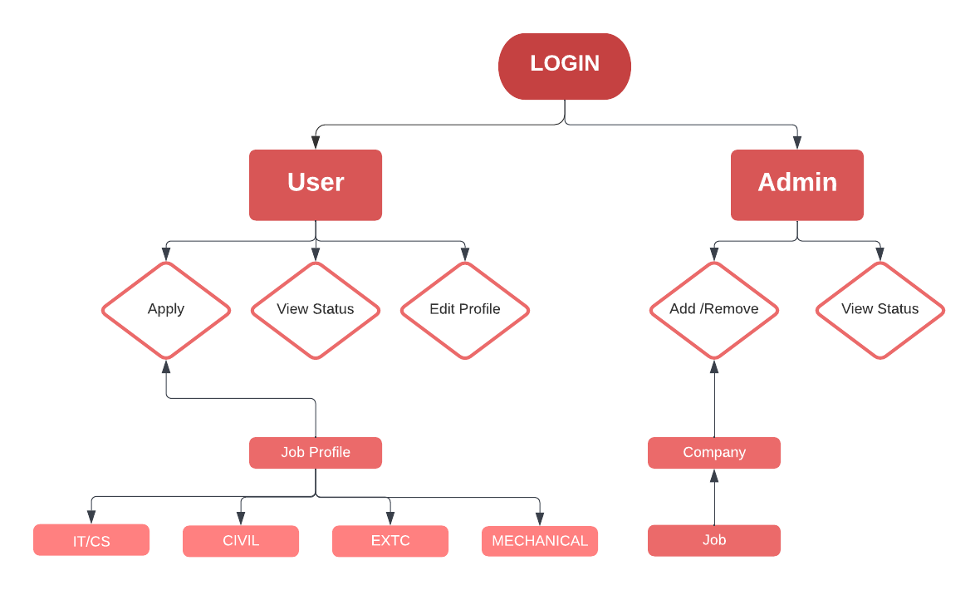
7. Block Diagram

Slide 10
Thank You...!!

